Slide 1
How to Cook Your Food and Fit into Your Clothes
All of the moves? Not quite, it’s easy to get lost, luckily we all have a story. So much to do, so much to see, why not sit back and play the shugabubulum.

Slide 2
Ways To Play
Fitting and cloth expression
Culinary Arts
Beach Body Contest
Pro Biotic Assessment
Candle Lighting
Being Basic
Simplistic Terpene Math
Creating Molecules
Calls
Texts
Programing TV
Making art
Long book reading
Social Security Hot Listing
Best Brew
Tight Roses
Little Costs
Shadow Art
Network Building
That Ass

Slide 3

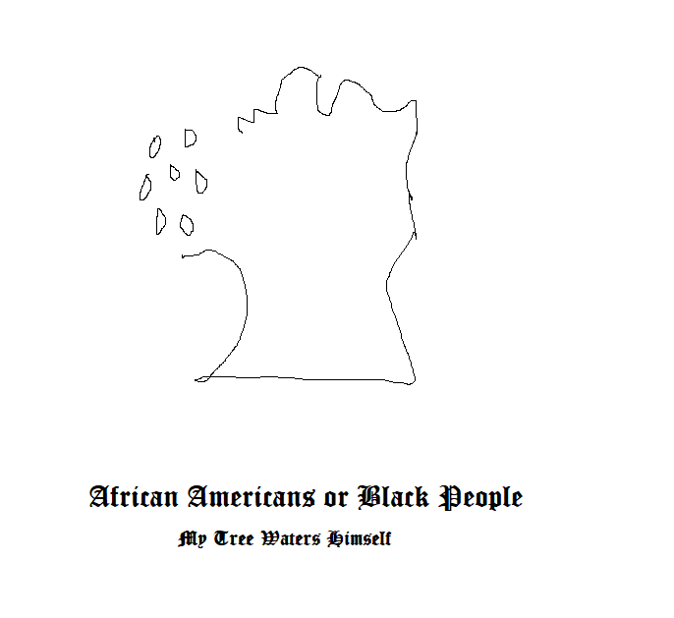
African Americans
The first African I met was my nanny. She had fake nails and her name was Rose. We had nice times like eating biscuits and doing homework when I get home from school.

Slide 4
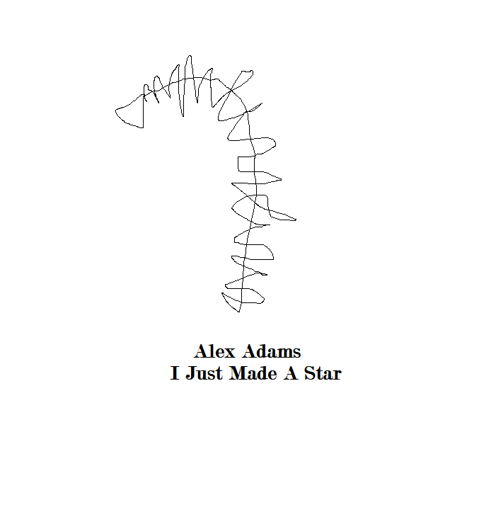
Alex Adams
I met Alex Adams at a party, and we became friends at High School. We, Jordyn and Her and Me, went out to the lake once and took a nice Pink Floyd picture. I knew she liked to try and make drugs, and life wasn’t very difficult.

Slide 5
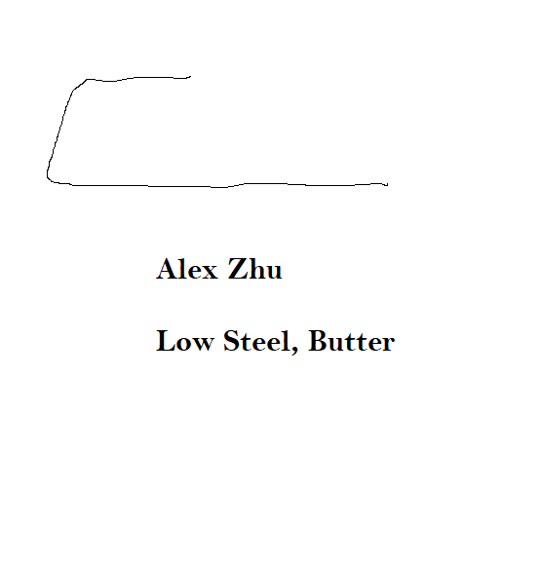
Alex Zhu
I met Alex Zhu on the bus when I was 15. I remember he kept a lot of guns at his house, and often brough gun magazines to school. I was scared of him, but didn’t show it. He was an upper classman than me. And He is Asian.

Slide 6
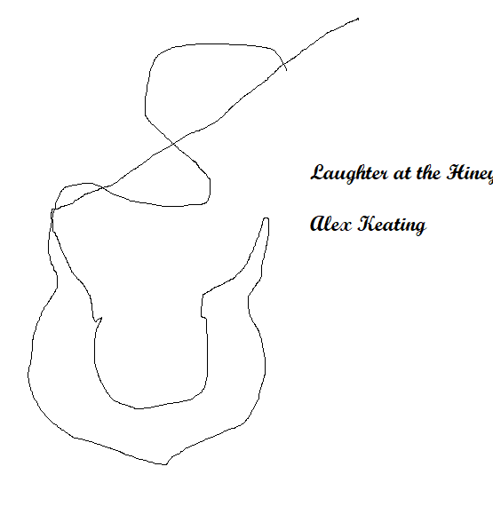
Alex Keating
I met Alex Keating when I was 13, he moved into the Mansion across the street. He has a brother named Josh and life was peaceful and good.

Slide 7
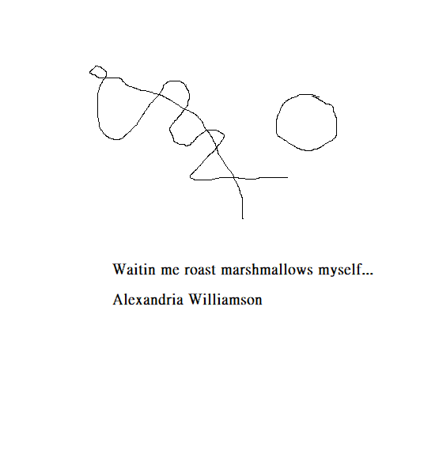
Alexandria Williamson
Alexandria was my friend in 6th grade all the way to graduation. I heard after graduation she made her way to LSU and did good as far as she let us know. I remember designing a radio station with her and painting pots and taking nice pictures next to my tree.

Slide 8
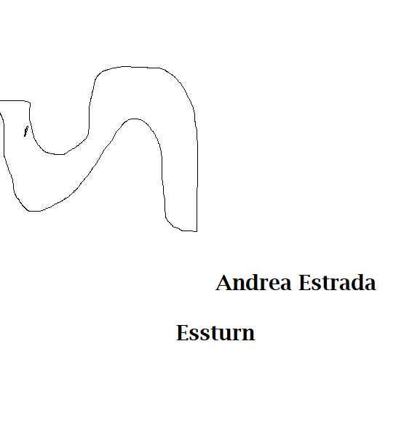
Andrea Estrada
I met Andrea as a young graduate, she was in dire need even desperate for the answer, I felt sad that her parents didn’t treat her right and get her to her scheduled design choice corral, just a simple corral at home about you choosing any fashion, or the variance corral, serving any food you would like.

Slide 9

Andrew Ferrero
I met Mister Ferrero when I was 18. I jumped off a rock when he didn’t kiss me. I didn’t know he was supposed to kiss me. It was way weird, but then I went to Colorado and got my apartment, that was nice. Haven’t seen him since.

Slide 10
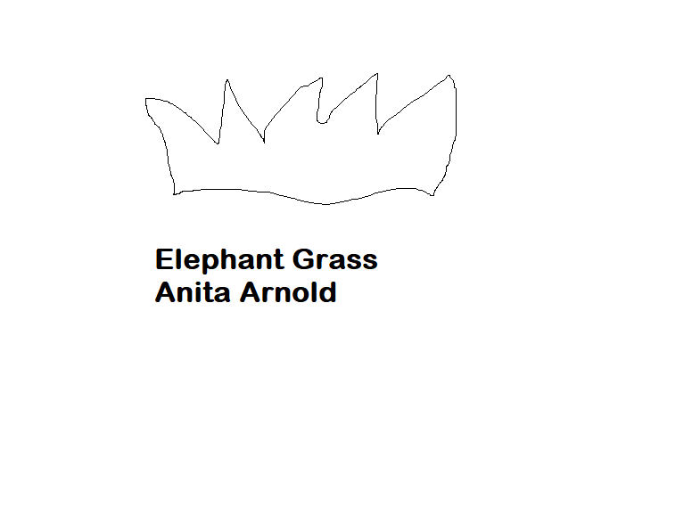
Anita Arnold
I met Anita when I was 28, pregnant with Joann. I liked how she looks and she really stood out to be a giving nurturing friend. She still lives in the apartment to this day.

Slide 11
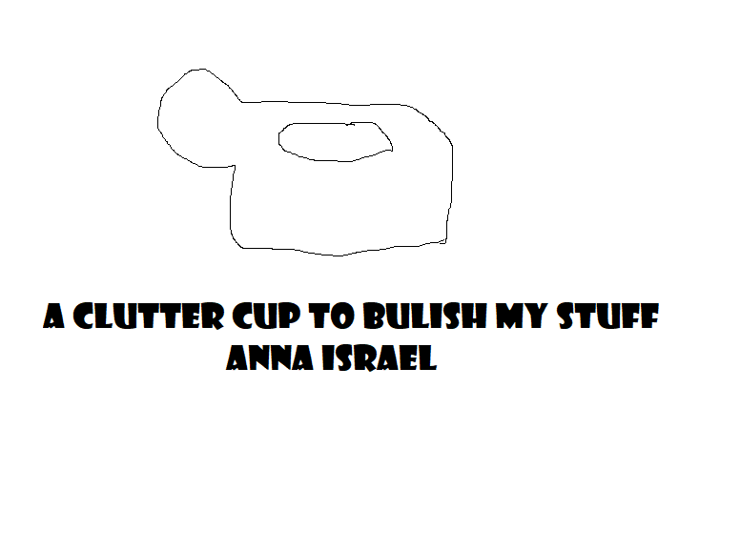
Anna Israel
I met Anna Israel when I was 20. She was at a party with a few sailors I met, and we went out to brunch together.

Slide 12
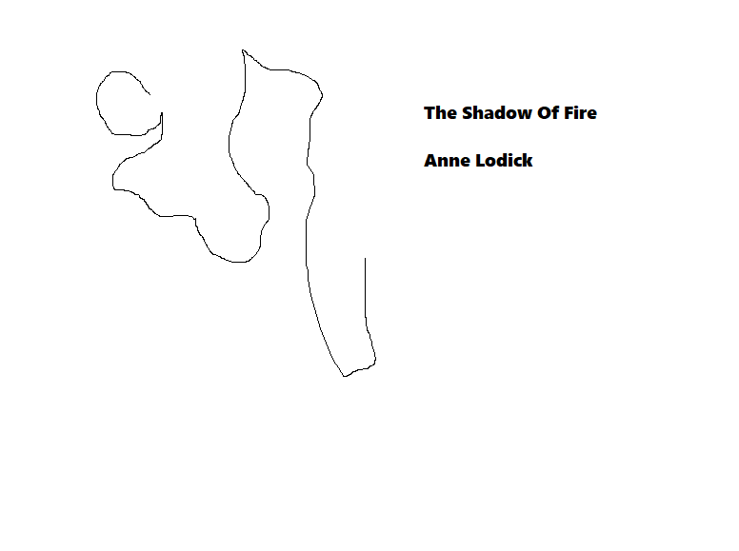
Anne Lodick
I met Anne at a party with sailors. I went over and had a party with her once, she was nice. I liked talking to her about jobs, curious where she went to school. I think she is a happy person.

Slide 13
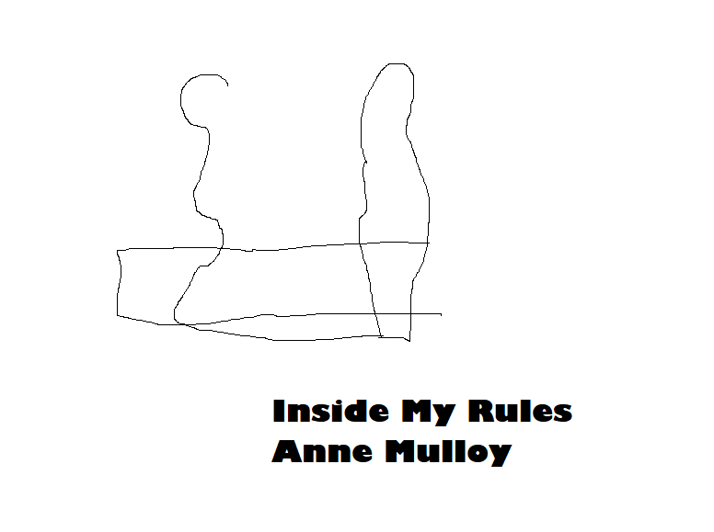
Anne Mulloy
I met Anne at a young age because she is my Aunt. I like her hair, and she has a nice voice. It would be great to talk to her again.

Slide 14

Anne Mulloy Skalsky
The most important thing to realize is that growing older can get you to grow into new, or when you had new when you were young, if you didn’t follow your life plan you would come back to simplicity and keelhaul.

Slide 15
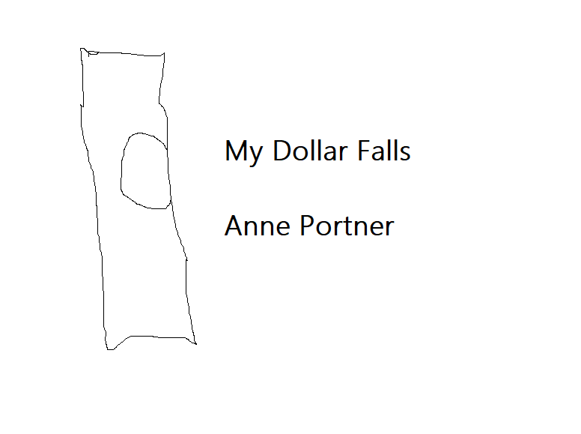
Anne Portner
Still haven’t met Anne Portner but I hear she is terribly intolerable and has a crooked personality and doesn’t really resonate in peace.

Slide 16
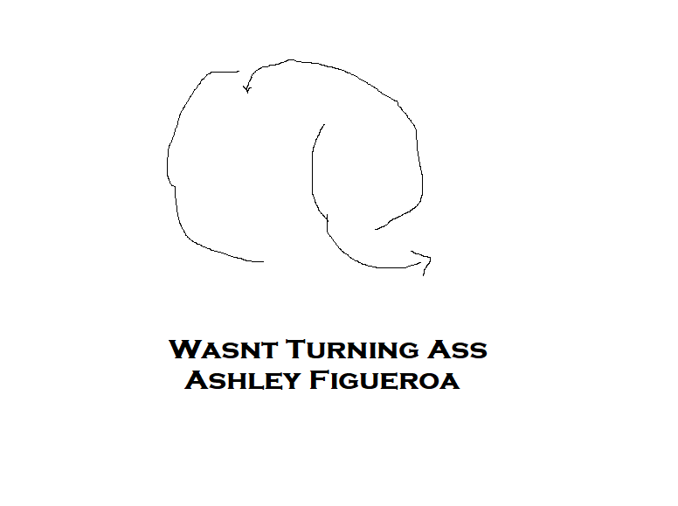
Ashley Figueroa
Better people for the state of California, doesn’t really constant with The One, and has A personal Problem not being Substantial and Eco Siezed.

Slide 17
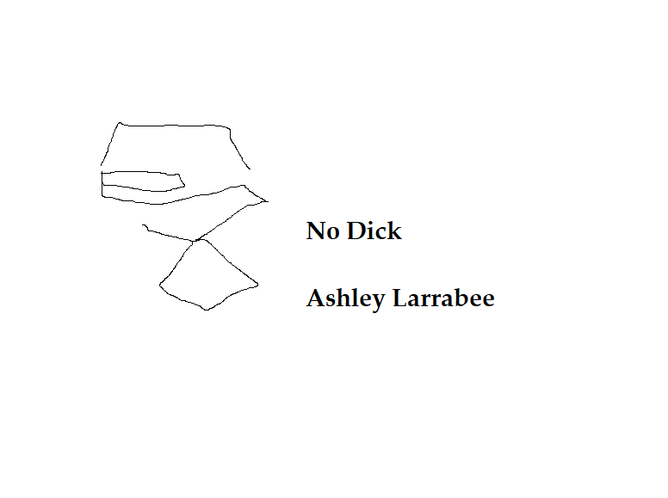
Ashley Larrabee
Kicking it like crazy was a future projection that I received when I met Ashley Larrabee. She said she likes sleeping with her smile on. I remember sitting at the bench saying “Wow Look how cool we are” but then saying, “We wouldn’t be here without you”.

Slide 18
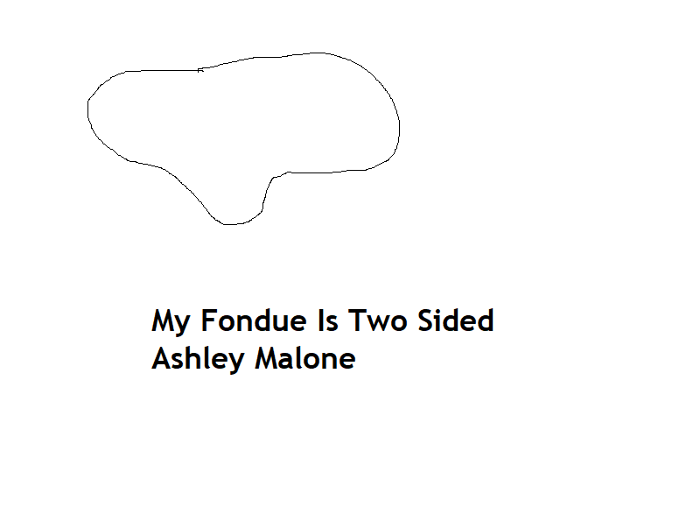
Ashley Malone
Hiding out in the sunlight is what I think of when I think of Ashley Larrabee. I like being with the direction of all lit Sweet and Social, and I feel like my family is getting there, her family seems like ones to impress about this material.

Slide 19
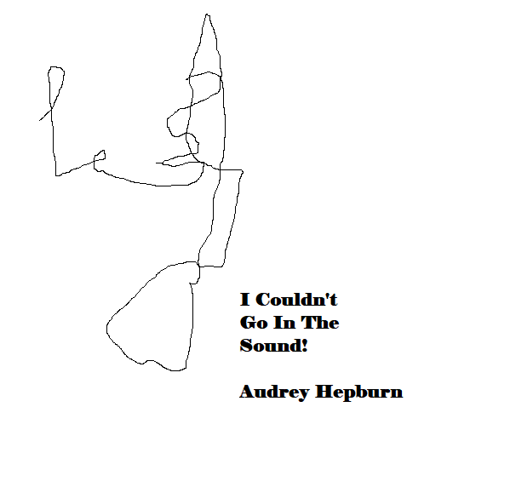
Audrey Hepburn
I like the movie Casablanca. I think she is an incredible actress and she deserves this picture.

Slide 20
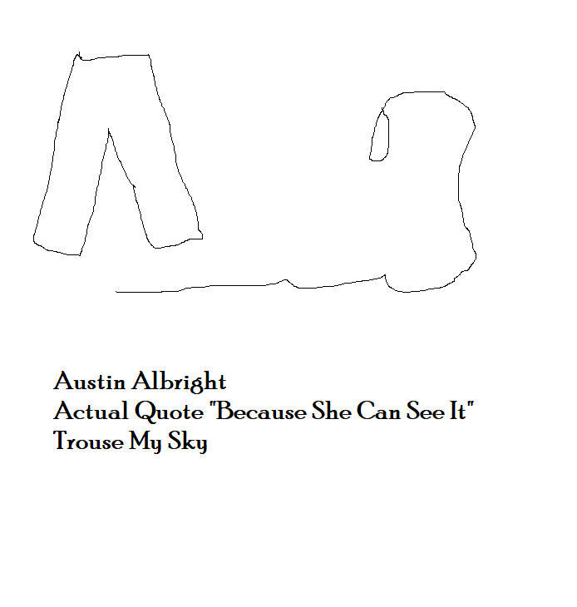
Austin Albright
I met Austin when I was 8 when John and Pam got divorced. She’s Chas’s son, he might have Bi-Polar with a girl named Camille. And I saw him fighting my brothers and thought he was an idiot.

Slide 21
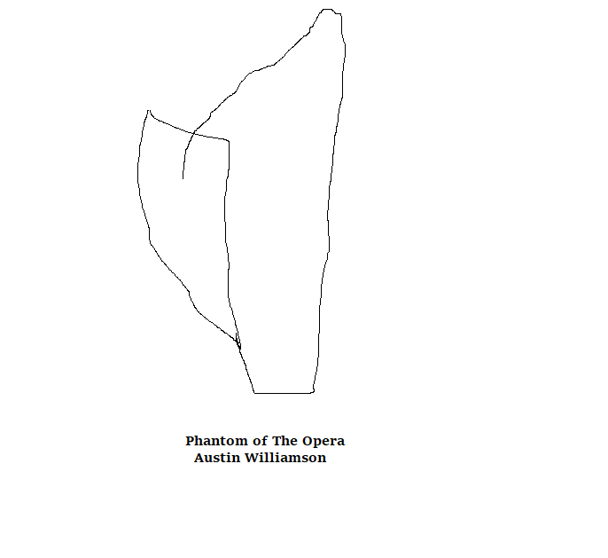
Austin Williamson
Austin and me made a boat one day, or I just had fun while Him and Ryan made the boat. I liked going out on the lake, but the boat gave out and water started pouring in and then we were afraid of snake, and life was Nice. Austin and me also pranked a few houses with forks.

Slide 22
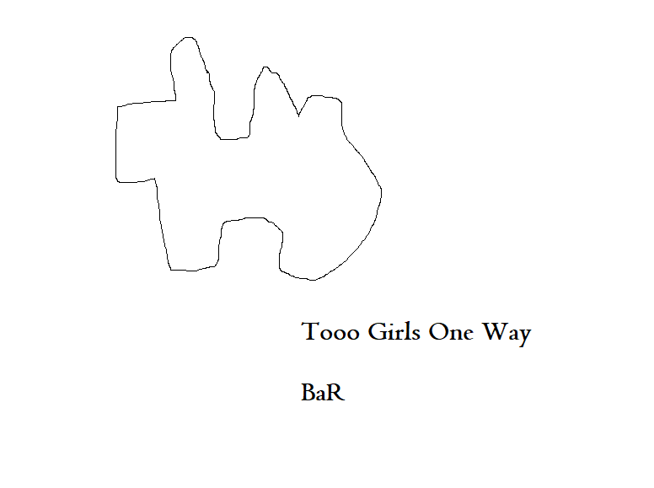
Bart Sibrel
I met Bart at my drunk driving incident and we watched some of his films he made. He a film management company, he wrote a book called Suspended by Faith.

Slide 23
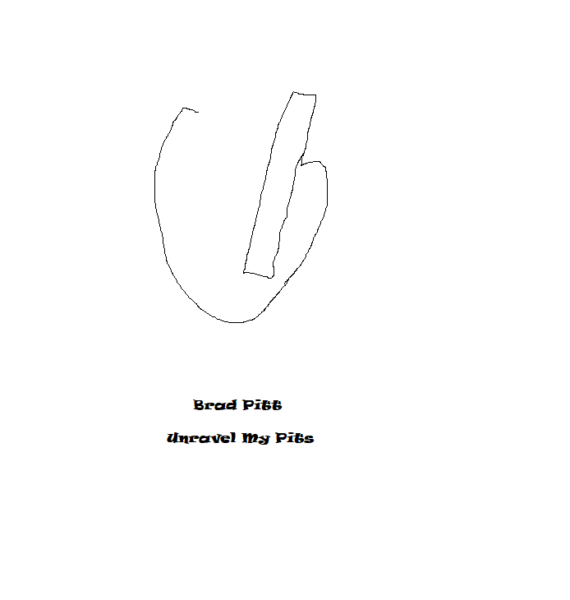
Brad Pitt
Haven’t met Brad Pitt but am suspicious about his fame and How he Got Here. Seems to be bro kicking with George Clooney at the casino, but he must have a passion as a chef.

Slide 24
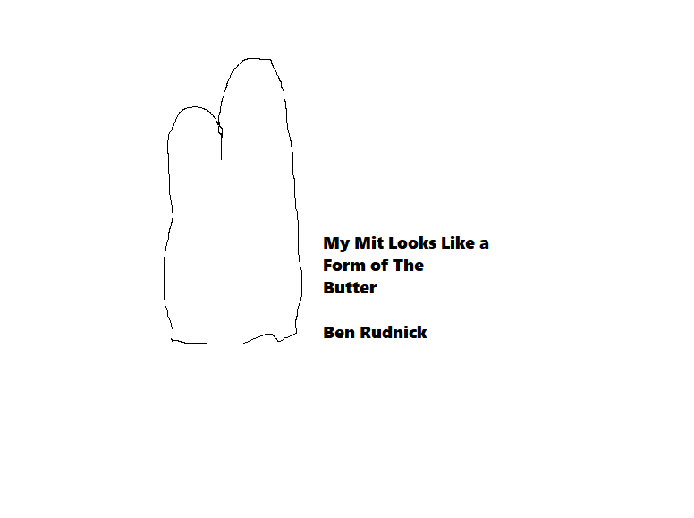
Ben Rudnick
Rode the train to check out the bar. Met Ben, he bought me a drink. Went out on a boat with him and his whole team. So much fun, the storm was scary though.

Slide 25

Bill Gates
I haven’t met Bill, but what I would say is eat healthy, maybe give some cereal Pointers. I hold my degree in nutrition, and There are so many bananas, any amount of darkness is a banana. Well you have to think, a current student, or a long lasting one. Ah! So much to know.

Slide 26
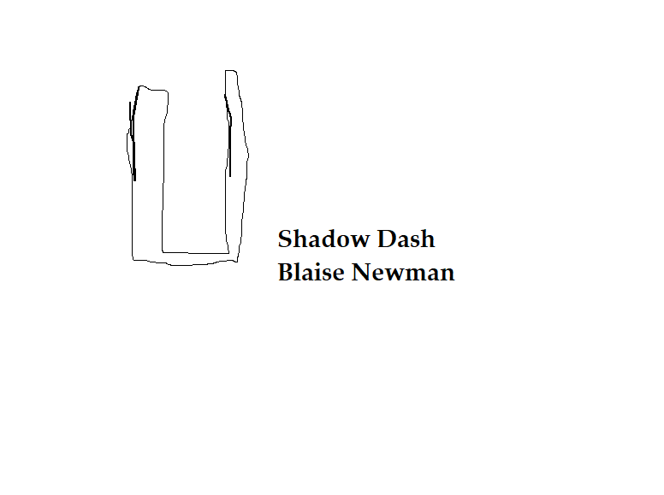
Blaise Newman
I met Blaise when I was 17. He was nice and young, and reminded me of my brother. We, me Jordyn and him, baked cookies for the holiday.

Slide 27
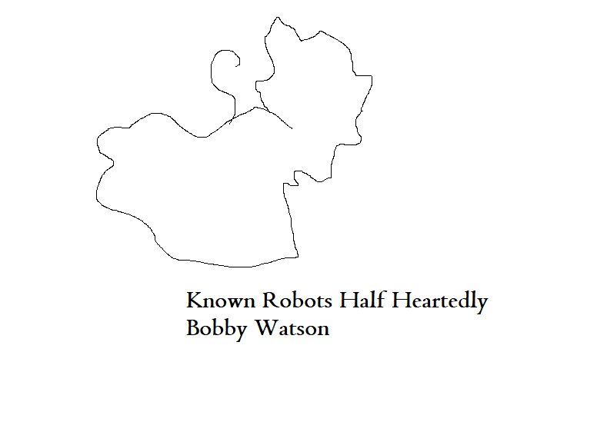
Bobby Watson
I liked this party I went to and all of the class was like “BOBBY, HEATHER how about a Beer!” aw, and I liked to watch TV with him and set off a fire. It was nice.

Slide 28
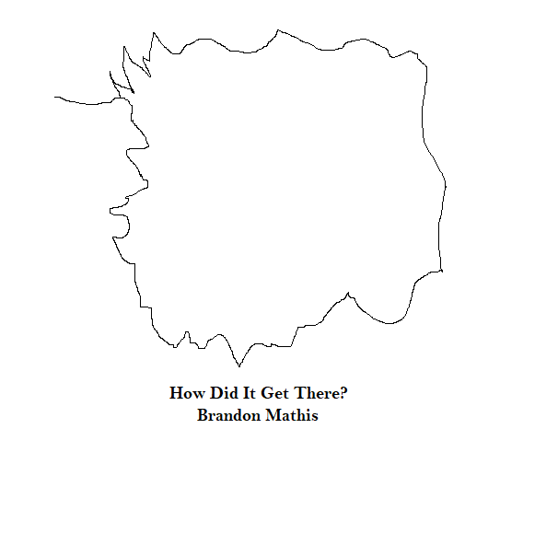
Brandon Mathis
Brandon Mathis cussed at me in class. He used the F word. And I gave him a weird look. Hm…

Slide 29
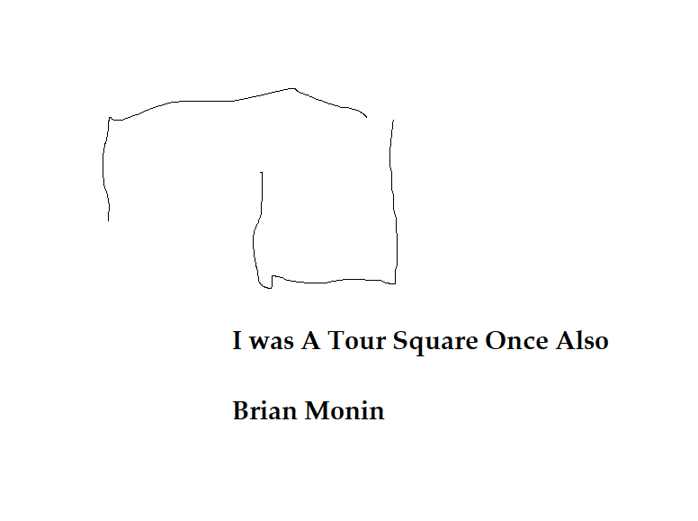
Brian Monin
Brian tried heroine in school. I helped save him. And he was like really bad and we went to go visit and bring him a soda.

Slide 30
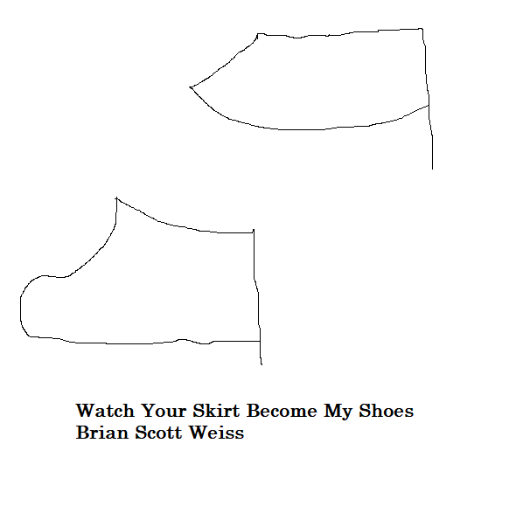
Brian Scott Weiss
I haven’t Brian. I heard he is mean and cruel and doesn’t have an outcome in a regular stance for me, but is he a Chef?

Slide 31
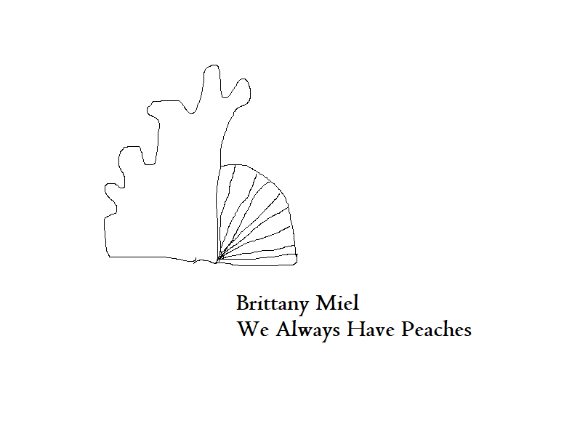
Brittany Miel
Me and Brittany were friends in the Chrysallis House program, she typed me in on youtube and found my video, and I didn’t get her last name, I hope she comments so I can message her because she might be a chef!

Slide 32
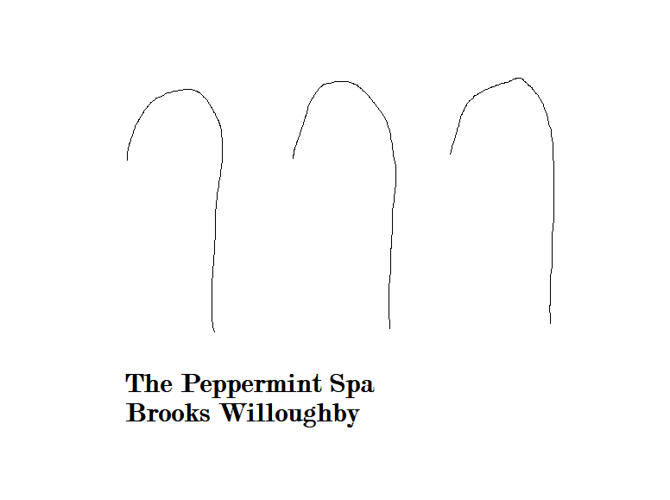
Brooks Willoughby
Brooks and I met in High School. We went to the lake a few times, he was really nice about going to his place, I wish for him to meet my Dad one day.

Slide 33
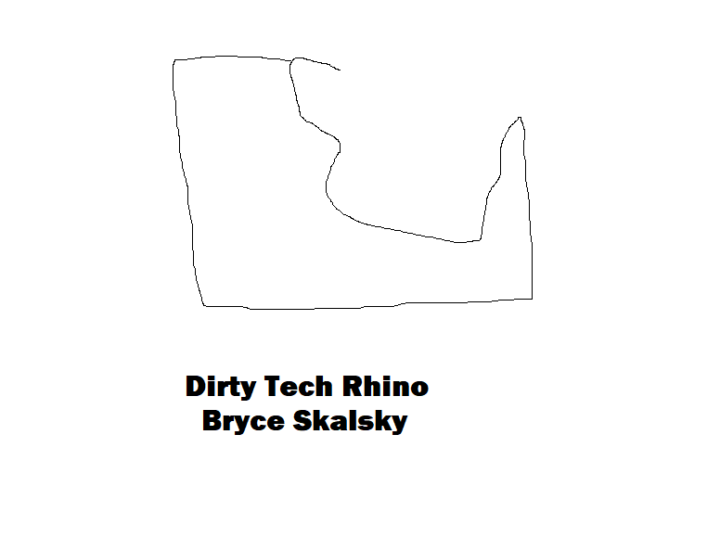
Bryce Skalsky
I met Bryce when I was Young, And Jordyn is my closest sister, so I think we Should All be close and Sweeten the Tea for our parents is kind of how I feel when I think Of Bryce.

Slide 34
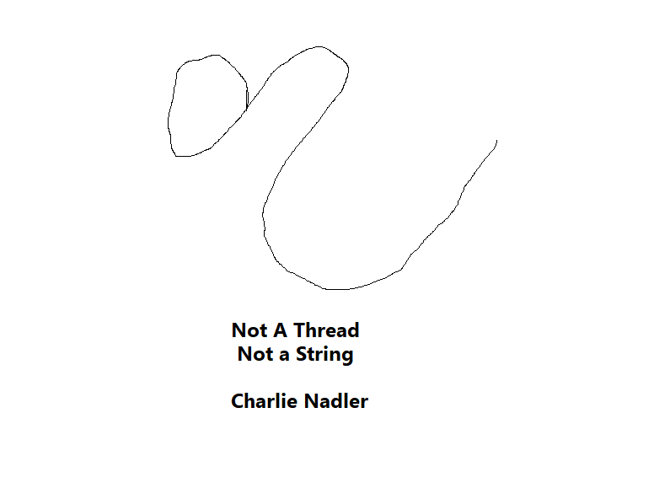
Charlie Nadler
I met Charlie when I was 19. We went to a few house parties and watched movies, saw Shows and Saw people balloons, but he kissed me and everything was great.

Slide 35
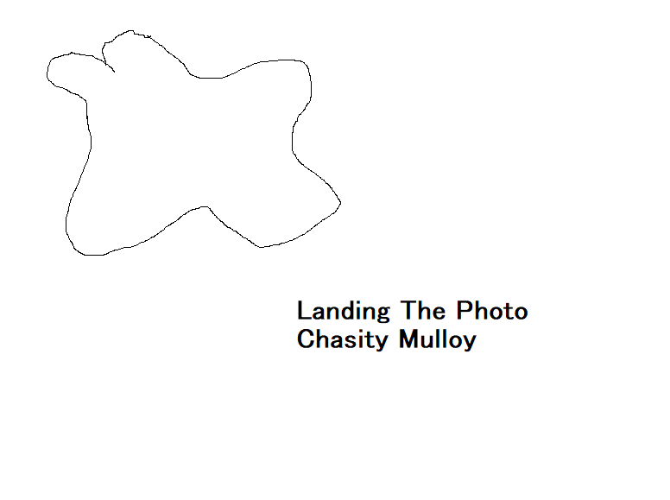
Chasity Mulloy
I met Chasity when I was 8. She gave me a white bra, thongs and birthday cakes. I wish she would feel towards me to just spend money on me. I think that it is important as a parent to just treat and not cause Drama.

Slide 36
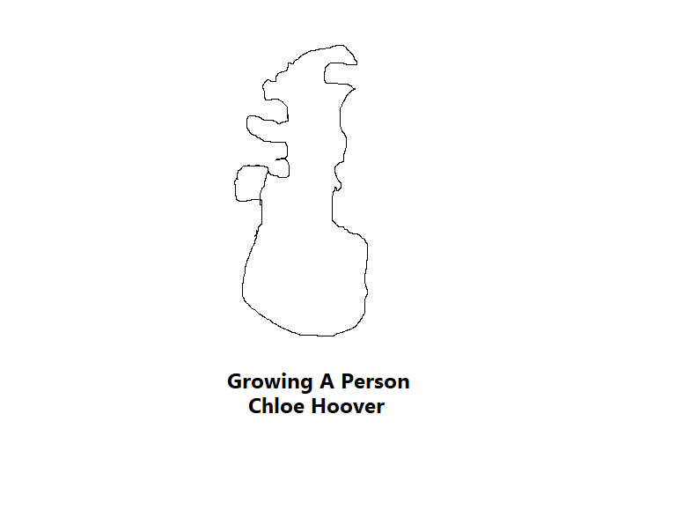
Chloe Hoover
Chloe and I met when I was 18. I was happy to be her friend and wear her clothes and what not, but I had a run in with her and had to restrain her. She should be thankful I didn’t call the cops. Except, she was sketchy about deleting me from her facebook. I had many pictures of us together, and thought she was hateful.

Slide 37
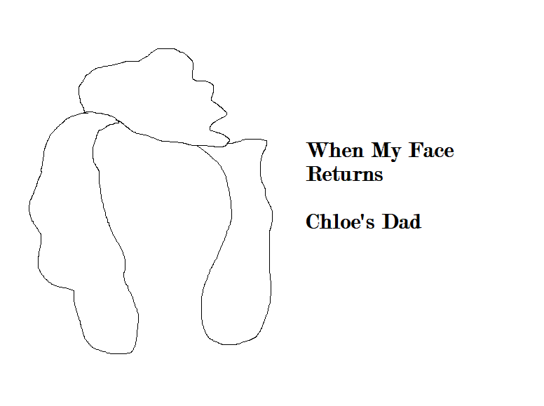
Chloe’s Dad
I met Chloe’s Dad going to Target. I thought he was nice, we just walked around it was a good intro to the East Coast.

Slide 38
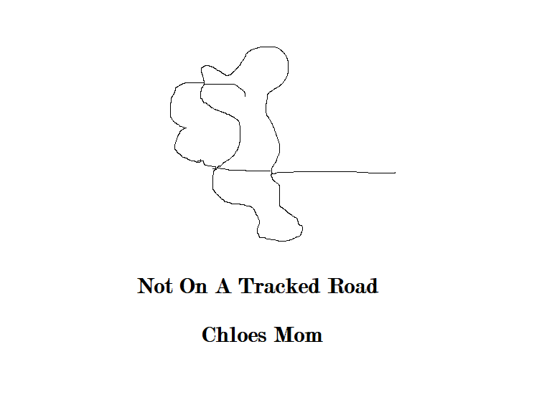
Chloe’s Mom
Chloe’s mom and I met when she took us to target. I remember she had like red hair. She was nice. But is she a chef!

Slide 39
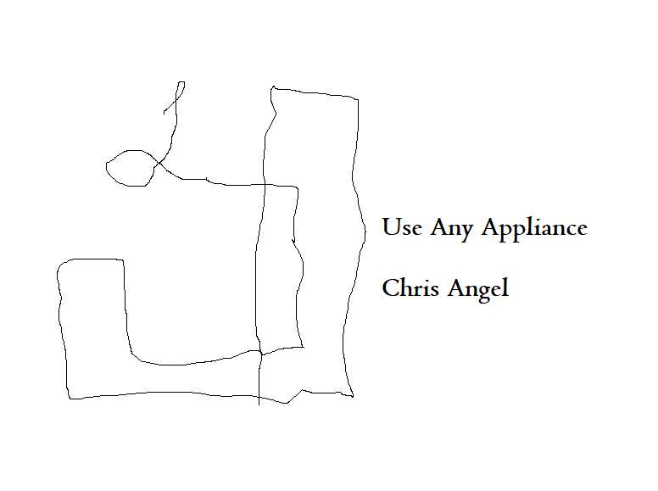
Chris Angel
A young Chris Angel would see the cooking as a confided Gateway to the Future. I see us all happy and Then I see Us All As A Gunt trinket trying to get him back to his keelhauling because he didn’t take his step. I met him at my internship in Hawaii.

Slide 40
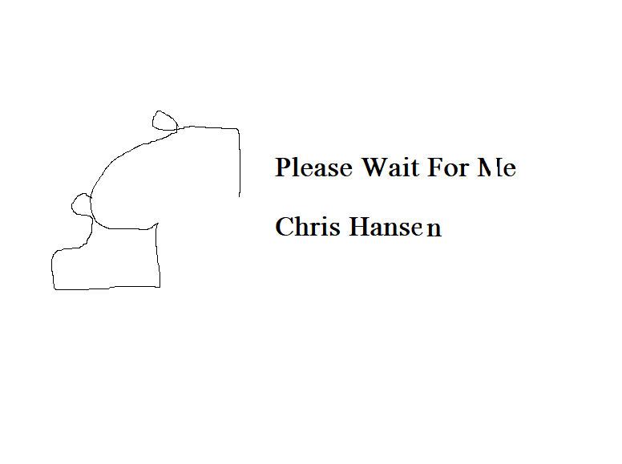
Chris Hansen
I met Chris in 6th grade when I started cheerleading. He was young and healthy, I’ll have to work on future pieces for his coalescing and encouragement to get a grip and take a step.

Slide 41
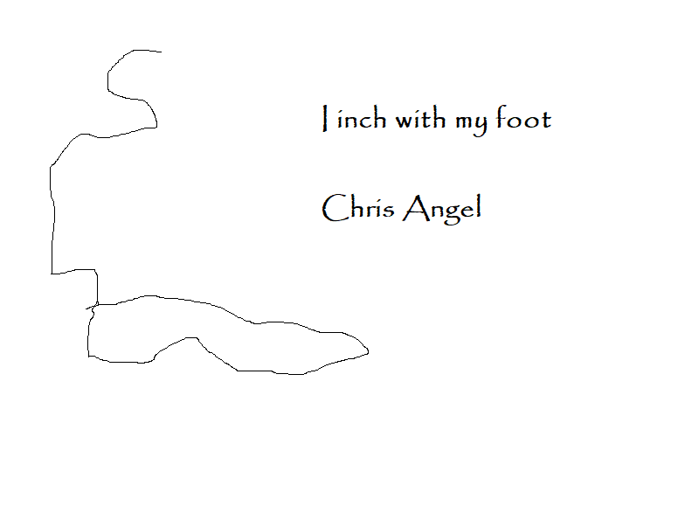
Chris Angel
Same Chris with the powerpoints, this is an original culinary fitting evil that he had to go back to because he didn’t take his step. We met in Hawaii.

Slide 42
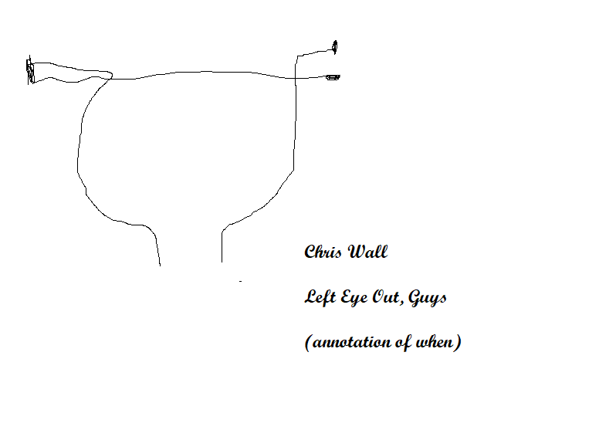
Chris Wall
I met Chris Wall when I was 27. He was kind of grumpy, not really there. Tried to explain this was more important than even his Job.

Slide 43
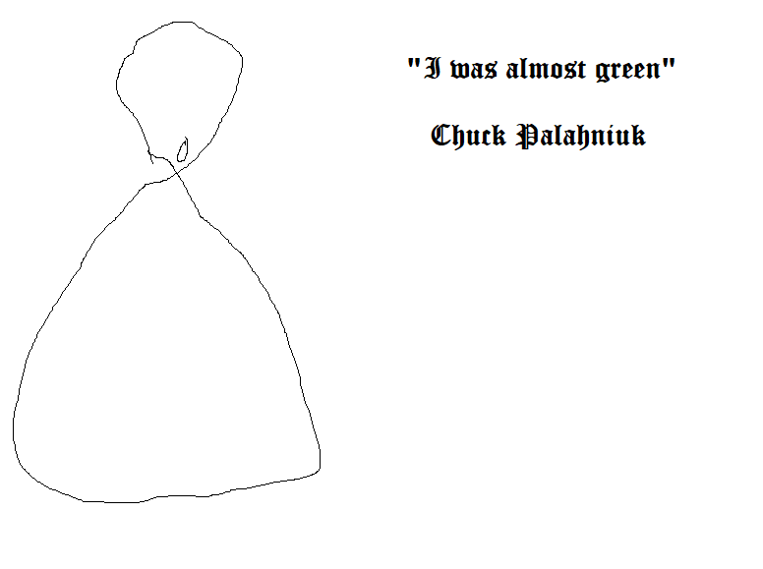
Chuck Palahniuk
I haven’t met Chuck Palahniuk yet, but he is a great author and I am his friend.

Slide 44

Claudia Estrada
I met Claudia when I was 25. She is Walter Estrada’s sister. She is nice and happy and might have a throw up problem called I see the entrance.

Slide 45
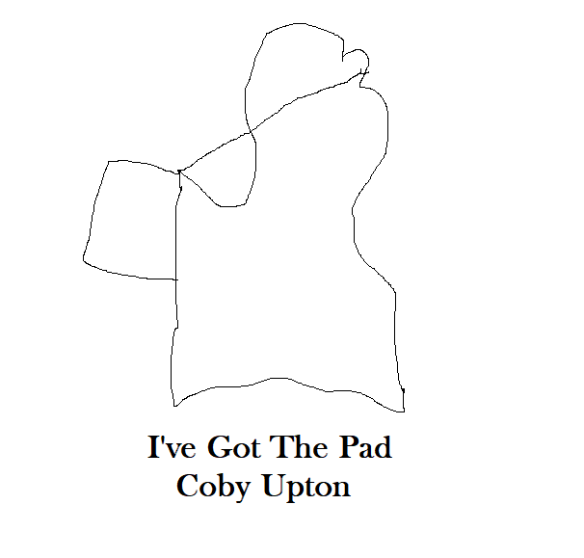
Coby Upton
I met Coby when I was 21. I was happy about his Neat appearance and nice job. He let me stay on his couch. I remember I was hungry and we went out to the Jazz Club. I have new propositions for him and all people at that.

Slide 46
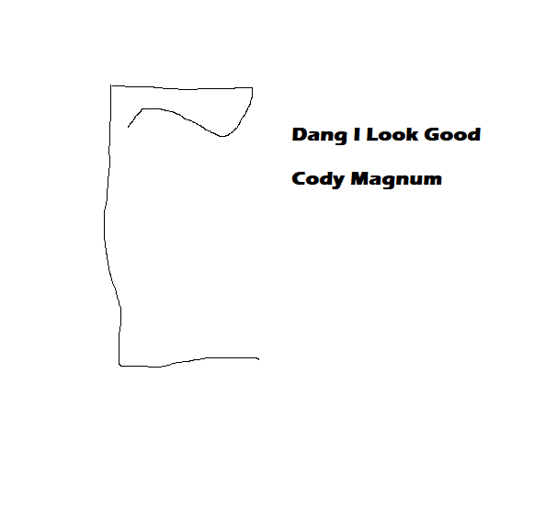
Cody Magnum
I met Cody Magnum when I was 16. He was funny and he likes to talk and we sat next to each other at graduation on the way to the graduation on the bus.

Slide 47

Connor Thompson
He was the head of yearbook. We talked a few times. He Really believes in himself and he Is A Chef!

Slide 48

Daniel Driensky
He wasn’t the most attractive man when I met him, but he was like 30 when I was 18. He liked beer, he came up to Rhode Island to do a photo shoot of me. He likes being a hoarder and I just think we weren’t that great of friends…

Slide 49

Danny Kelman
I met Danny when I was 16. He went to the same High School as me. He was interesting and I thought he was attractive.

Slide 50
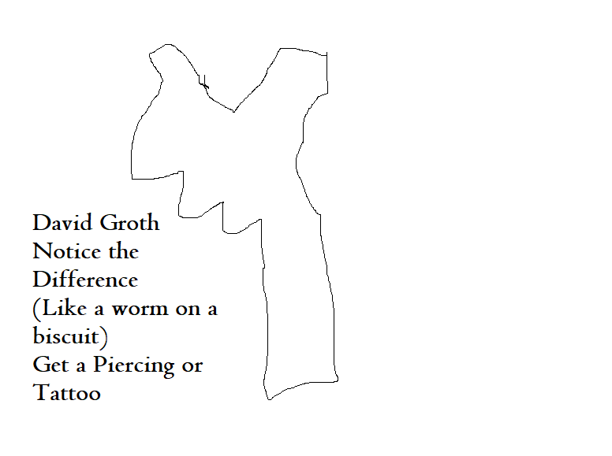
David Groth
I met him when I was 19 in Hawaii. And I like All of the Grooves with my new ukulele. I plan on getting my next ukulele in Hawaii with Walter.

Slide 51
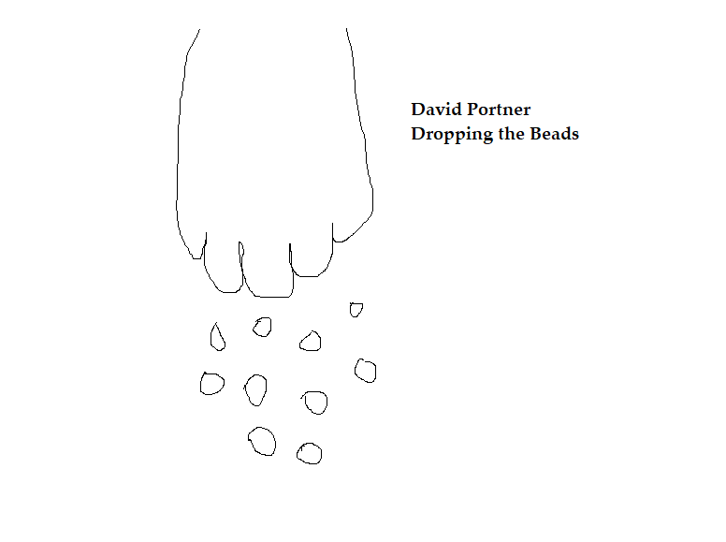
David Portner
David makes me think of the people I have included that I haven’t met, who might really want to be Chefs, well I could create a new powerpoint every time I meet one. With ALL of the characters. I love him and he should love me to. What if we went to El Salvador in July?

Slide 52
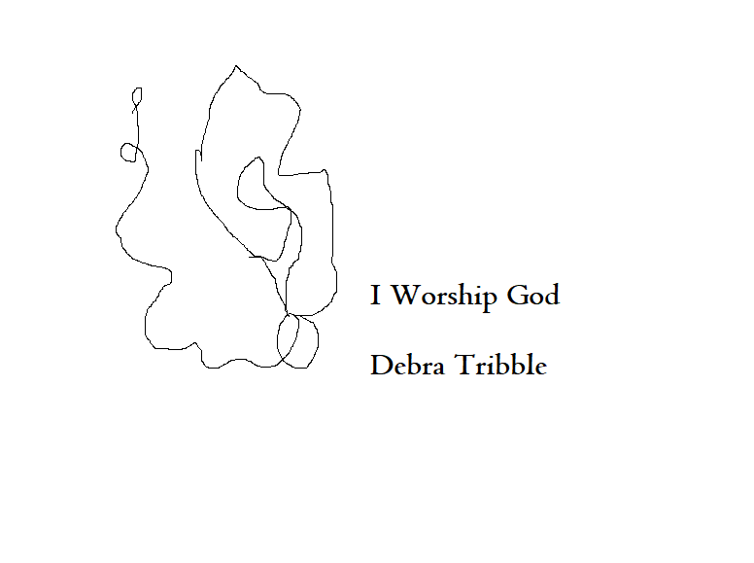
Debra Tribble
I met Debra when I was pregnant with Joann when I was 28. She gave me nice gifts and I was very happy about her.

Slide 53
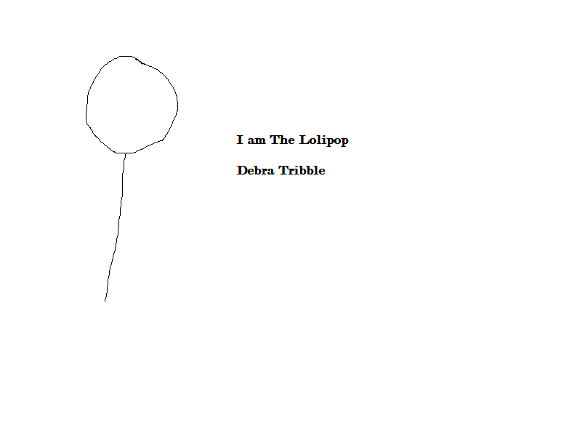
Debra Tribble
This is a starting point for Debra Tribble. I have it in my original deck that the sugar war in her mind SHATTERS and creates depictions of worshipping god, what she cooks.

Slide 54
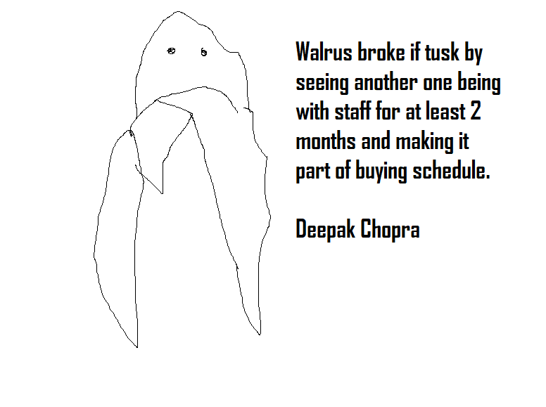
Deepak Chopra
I met Deep, what all of his name that he told me was, when I was 21. I went out of my way to make tea one day, he said thanks. He also helped me go to the emergency room when I broke My Wrist.

Slide 55
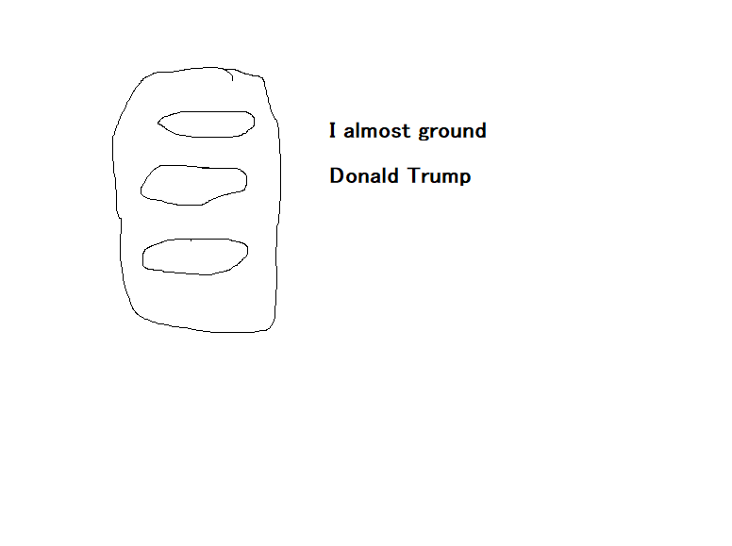
Donald Trump
I haven’t met Donald, I think he is a good chef. I found him on my TV when I was a teenager, sort a weird but I don’t know about him being the president. He’s kind of big, I like small presidents.

Slide 56
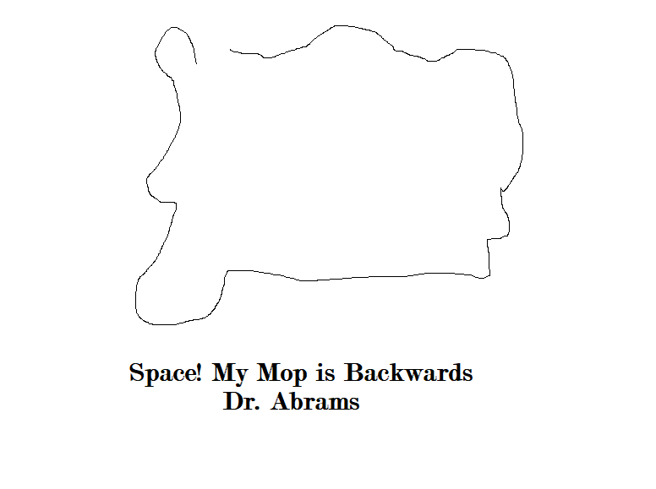
Dr. Abrams
I met Dr. Abrams when I was 20. She printed a book about Mahadeva and Pavarti and she Liked my story quilt.

Slide 57
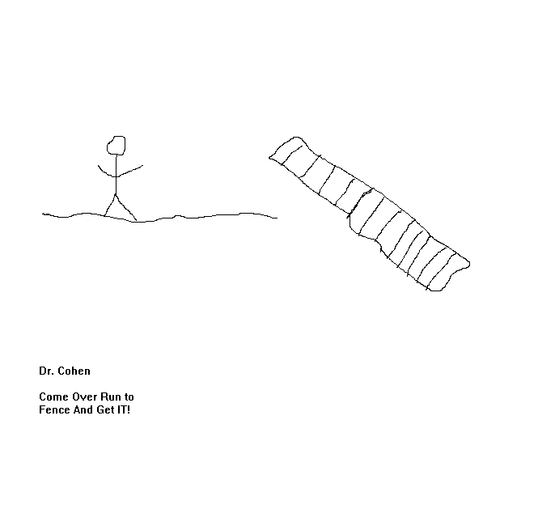
Dr. Cohen
I met Dr. Cohen when I was pregnant with Joann. She Loved Me and I got to do a seminar At John Hopkins Hospital.

Slide 58
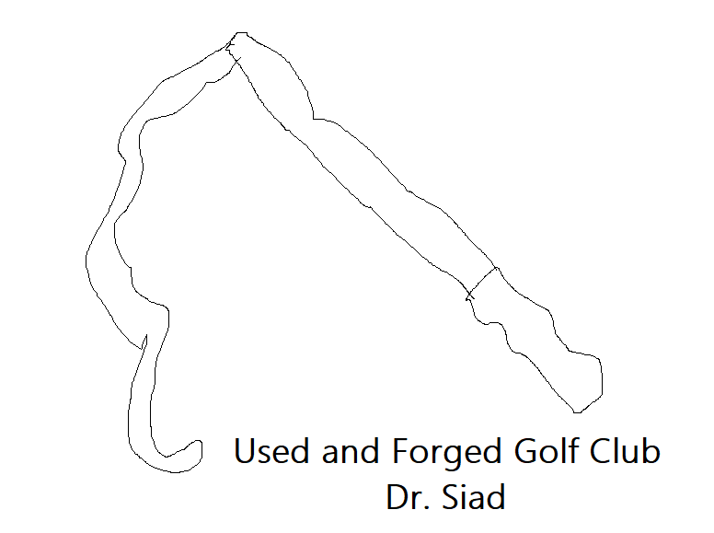
Dr. Siad
I met Dr. Siad when I was 28. I find her to be extremely ugly and don’t ever want to be caught colding her. And no, I wont hire her.

Slide 59
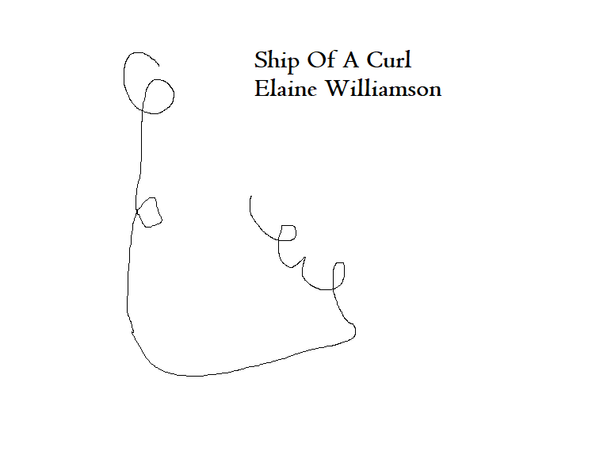
Elaine Williamson
I met Elaine Williamson when I was 13 and I love for the days I was working at her company “Bella Cosa” when I was 16. She is nice, I saw her in a bra once. I liked eating her cheesecake.

Slide 60

Emma Watson
I met Emma Watson when I was 18. She dined in at Kebob and Curry, I was tipped $10.

Slide 61

Ensieh Zare
I met Ensieh when I was 17. She was an exchange student at Jordyn’s Plano High School. She is from Sweden, taught us about fashion blogging. I made a plan to start fashion blogging in 2025.

Slide 62

Eric Altieri
I met Eric Altieri working at Wildflour Vegan Bakery when I was 20. I give a kiss to the sky to him because he was cool and collective.

Slide 63

Erica DeMallo
I met Erica when working at Café Zog in Rhode Island. I was 20, she was nice and I was gaining restaurant experience.

Slide 64

Erica Mayes
I met Erica in middle school. We were friends and I went over to her house for an afternoon. She has red hair and is a total babe!

Slide 65

Goetsch Tien
I haven’t met Goetsch, and I think of the cleanliness and my appearance getting better and wiser, I liked her episode that I saw while I was staying at the hotel.

Slide 66

Grandpa
I know my grandpa is the judge, and clearly took off and left the country before I was born. I hope he is okay.

Slide 67

Gryphon Sage Anderson
I met Gryphon when I worked at Jamba Juice when I was 16. I really liked his video taste and thought of healing prospects for his adventures. He is a loyal to truth, but I’ve tried to convince him to believe in the GrAJ Mahal.

Slide 68

Gunner Mraz
I met Gunner in High school. He is an interesting fit, small and big. He looks nice for hiking or riding a bike. I liked him, and hope he is doin well.

Slide 69

Guyon Sanders
I have yet to meet Guyon Sanders. I hear he is quite the techno wizard with lots of dollars for life and living even music. He is an incredible chef, and He knows the road, as in weighs outstanding privilege To Suicide and Atherosclerosis.

Slide 70

Hannah Mulloy
I’ve known Hannah a long time, like since I was Born, she notices me and thinks of our greatness as a Royalty. And doesn’t DRIVE the cause, lets the Cause drive her, only if it is growth of the heart and soul, build don’t die!

Slide 71

Hauke Pohl
I met Hauke when I was 18. He is very handsome, smart and harmonious. He has a beautiful jaw line, would love to make him a chef model!

Slide 72

Heather Caton
I met Heather when I was in 6th grade. Her mom was the teacher. I liked her voice and she taught me a fun game called “7 minutes in heaven”. She might be a nice chef.

Slide 73

Heather Dieter
Me and Heather went to the same middle school and High school. We didn’t really hang out very much, but what we really like was that both our names were Heather.

Slide 74

Heather Mulloy
I love myself. I love how I stood up for myself when I was in school and they showed the child abuse case, its like reassurance that I can present this information the way I want. I just hope and pray my mom gets caught soon, she kind of supposed to do as say.

Slide 75

Heather’s Dillema
There was this girl I met when I was in kindergarten that I swore was a chef. I had a strange dream about her, how her mom didn’t get enough respect to shop regularly at the store, like someone defiled the aisles every time and provided them with Shanti food.

Slide 76

Heterotrophic Face Paint
I think all people named Fran were seen as this evil, a super horny button, like a mini penis disconnected riding the orbits of the earth, claws and a cape.

Slide 77

Ian Crystal
A day in Hawaii I met Ian. He was from the same city Francesco went to high school in. I thought he was nice looking, not as nice as David.

Slide 78

Ilan Musk
I haven’t met Ilan Musk, but I heard he has an interesting personality and knows a lot about computers. Including Space, which I hope it all started with a designer who shined their light on them, forever a guide.

Slide 79

Ilan Schnell
A great day turned into a great night when I lied to Ilan Schnell and said I am from Argentina. He was great about the whole needs and necessity thing we even programmed that my cold data wont have to arrive at his company anymore, he also took me on two vacations! What a great friend…or I mean what a great first occurrence.

Slide 80

Isaiah Pottle
I met Isaiah when I got the job at Wildflour Vegan Bakery. I loved it there, we didn’t have any extra curricular time, but I noticed his professionalism and style, and how he didn’t like to be bothered.

Slide 81

Jack Skalsky
I met Jack when he was just a baby, he accidentally cut himself on the Christmas ornament, one just fell off blah. It was fine, he is already a graduate from high school. And life is good.

Slide 82

Jaclyn Yetter
I met Jaclyn in High School. We weren’t close friends or anything I just remember her.

Slide 83

Jade Moon
An interesting person I used to work with at Forever 21. I liked her name and I was the only associate on one night, when the store got trashed by huge crowds of shoppers. Was pretty awesome. We took a few breaks. I was stoked.

Slide 84

James Nelson
I have never seen a girl turn into a guy, but I wanted to know if it effects the way you cook. Isn’t my idea, but I met “him” when I was a freshman in college, he was a “she” and Life was pretty nice.

Slide 85

Janice Mulloy Wieck
I met Janice when I was young and wrote her a letter, I felt as thought our relationship was supposed to get better the more and more I learned, I think she has a tremendous head cold and must take the information presented to her seriously. If only she’d agree that I can easily get her a ETE tattoo.

Slide 86

Jason Owens
I met Jason around when I turned 27. He bought me a fruit cup. He wasn’t really mean but he liked to get out and get around and drink and smoke.

Slide 87

Jenson Lavallee
I met Jenson when I was 14, I used to love his hair, and I liked giving him a hug before class. It was fun see excitement and have love stories playing. Because we care about our Moms.

Slide 88

Jeremy Alliger
I met Jeremy when I was 21. It was nice to work at a Halloween Party and we all did the high bakes and the match you laters. In our Costumes. The cops came and I hid in the bathroom. Someone did knock and I stayed silent.

Slide 89

Jessica______
She is a really nice chef, me and David may make one. I believe it to be true that all Jessicas want to catch the phone and present a nice carrot.

Slide 90

Jessica Von Hoven
There is a girl I met in Middle School who I liked because she was pretty and giving, but I think in her family she might have whats called a “Dominant Characteristic” and so I see her cooking nice fly aways, like confetti cake and orzo.

Slide 91

Jimmy Fallon
I haven’t met Jimmy Fallon, but I find his show to be adult, and his mixtape is most likely low key high flies, he might be a Mexican, not sure if he doesn’t sit around all day then he is a fit Mexican.

Slide 92

Joann Van Rainbow Mulloy
I never Let people lie about my daughter, but the Real gig is to have an associative part in my life, and to be sure of likes and dislikes, and o have her set up for success. Pretty easy being a Clean Freak.

Slide 93

John Mulloy
I witness John, my brother, get beaten by my mom. I find him to be clever and cue-tickery, and he totally should always like how he is treated because the other threshold isn’t very beguning. As in meet with the threshold sometimes, gaining high intensity and Letting go. A funnel cloud! Haha

Slide 94

John Mulloy Sr.
My dad likes to laugh and holds pretty parties and thinks of doing girls makeup. He is kind of annoying sometimes, but gets by doing a simple palm petit and Doesn’t need to surrender just needs to make sense of things.

Slide 95

Johnny Goetsch
I met Johnny in Hawaii. He trusted me with his camera to take picture of him while he was surfing.
Gosh I had so much fun and I loved all of my Hawaiian actions.

Slide 96

Jonathan, Faye Group Home
I met Jonathan when I was 28 and pregnant with Joann. And I liked how he was professional, I didn’t like that he was crunchy. It was okay, everything was good once I paid them for the place I stayed at.

Slide 97

Jordan, Sam’s Assistant
I met Jordan when I was 28, before I got pregnant with Joann. He was nice and listening to holy music.

Slide 98

Jordyn Ashley Newman
Jordyn is amazing! She is my business partner and collects the multiples for my company. She is brilliant at art and writing, and I can’t wait to meet up again.

Slide 99

Joseph Albright
I still haven’t met in person but I liked to watch Austin his son try to persue getting close with him because it meant that Chas should have probably thought about taking better care of Austin, like by getting his Sales Tax Permit.

Slide 100

Josh Auld
I met Josh in middle school. We had a class together called Robotics. I remember he had gross stuff on his shorts and some people were making fun of him and I told them to stop making fun of him.

Slide 101

Josh Keating
I met Josh when I was 13, I liked doing various things and we liked to be Intuitive about growing and aol messaging. He lived across the street in the mansion.

Slide 102

Justeen McDonald
I met Justeen when I enrolled for extra curricular competitive cheerleading. We did a good job and won many awards, we went to the mall together many times, and I had my first cigarette with Justeen.

Slide 103

Kate Holden
I met Kate Holden with Mr. Ferrero, we like art and music, and started a minor production that actually we found belonged to someone else. She was nice and pretty and I liked her “Chelsea Hotel” story. Kind of an art guru.

Slide 104

Kathy Unruh
I met Kathy when I was young, she is my aunt. She said something weird to my stepmom about egg and reproduction surgery which I am highly against, and I just didn’t like that my parents used to make fun of her thought she seemed not to mind so I guess I learned that some people need some roughage to keep going, and I certainly don’t because I am a diety.

Slide 105

Katy Pery
I haven’t met Katy Pery. But I like her “I kissed a girl” song, and I always just thought that life was too easy to just go to shows, but I want to see what other songs she will make for fame, and gosh she would look great as A chef!

Slide 106

Kria Brekkan
I haven’t met Kria Brekkan yet. In my mindframe, someone hacked me while I was in the hospital and I thought it was uncalled for then I thought of David and she got brought up and it just wasn’t a Truth Factory, I don’t typically talk to people who make things up, I like starch and sweet and Clear, like I’m Not gonna destroy a carton of ice cream without saying grace.

Slide 107

Kyle Murphy
I met Kyle Murphy when he was in high school with me. He came to my door one day and said do you want to go on a walk and I went to the lake and We All Felt Like Giants!

Slide 108

Larry Wieck
I met Larry when I was 13. He was some nuancance of my grandmother’s who wasn’t the most appealing to me, so I just think about him not selling a house and it seems fitting.

Slide 109

Larry Wieck
Larry, if he were to get good and take his step by asking for a friend to get a tattoo of a sunflower with om inside and ask another friend to come with, he would step over this hump of just cooking YALL. Kinda gross reminds me of petrol.

Slide 110

Laura Mars
Heated conversations at continuum I am assuming. I think this girl is a criminal, and yall should surround like I saw, and Root On! And Then she’ll have klefulkta confuse when she gets caught! But, is she a chef, I think that cooking No More South Korea would be funny. We met in Austin.

Slide 111

Leslie Davis
We met in high school, she was an upper classman, she is very rude and I don’t know if she has the stamina or guttural strength in cores of planets as well as shooting out or purging waters of the vagina to assume that her system was built on a guilty figure of “oh I was almost”.

Slide 112

Lily Kardon
I met Lily in Hawaii. We also met up in New York. She was cool and collected, and has a nice yoga body.

Slide 113

Mark Zuckerberg
I haven’t met him in person, but he messaged me online, and I told him my ICE, in case of emergency.

Slide 114

Mary Magdalena
I met when I was 22 when I first got to LA! She was really nice, I think I cooked some breakfast. And everything felt good. I liked the Kiss on the cheek oh lets take pictures. She is actually flying back soon.

Slide 115

Mathew Skalsky
I met Mathew when I was young and he and I got to do stuff online on Everquest. I like all of the things that he said. I am nervous for him though, I hope his sister is making use of her time teaching the boys the real space anomaly.

Slide 116

Megan Welch
I met Megan when I was 14, we were in competitive cheerleading together, and the Sudden Sleepovers resulted in confusion because we typically don’t get bad movies.

Slide 117

Melissa McCann
I met Melissa when we had Commencement at University and we got donuts and still made it to our prime spot. And she did the same internship at Kalani that I did and that was cool.

Slide 118

Melissa Newman
Jordyn’s Mom! She is nice and amazing and I like working with her, and I find I do more work when I see mother and Daughter Together.

Slide 119

Mermai Parker
Jordyns daughter on the stand, she is due pretty soon and we Like having her as our guest because she tells of a lot of the colors, and Jordyn looks beautiful in her shining colors as her mom!

Slide 120

Michael Landon
I haven’t met Michael Landon in person, though I liked his show where I learned who Constantine was. I just hope to make him a chef one day, or storyboard involving what call a power skill that could get honed through our company.

Slide 121

Michelle Hensley
I met Michelle when I was 16. She went to the same High School as me and I think that she is very smart and they were really nice at Rachel’s Birthday Party. And I forgot Rachel and I felt bad but maybe I’ll have her as a china suey, fun loving party.

Slide 122

Mike Perrault
I met Mike when I went up to Washington to write a book. I liked his place, and the apartment complex was nice. Thoughts of what If I am Only Here Once. And That sounded good. He was kinda full minded needed some work. Ill look him up one day soon, help him out.

Slide 123

Misha Mryh
I met Misha when I was in 3rd grade in Mrs. Robins class. I invited her to my birthday party, and we had a ball with tent outside and everyone looked cool and um, well I think that she is very vulnerable and I hope she gets her man.

Slide 124

Mister Crawley
Had him as a teacher and don’t know if he is real or not but I Claim he is real during many parts of the day. Or maybe he might be double echo. I think it was nice to have him criticize me in my knife cuts.

Slide 125

Mister Green
I met Mister Green in Washington and showed him my resume he is a cop and he was a little nice and took me out for ice cream.

Slide 126

Moby Dick
I haven’t met Moby Dick, but I am curious as to if I name a baby Moby, considering the Ahoy side of my family would they find that we are related.

Slide 127

Money Went On My Mind
I feel that my money matters are private with David and our first son or daughter may very well cook like this.

Slide 128

Mort Denhil
I liked that he was essentially turning himself in when we met on the subway oneday. He got my facebook and I don’t know, I don’t really agree with war our altercating financing, I see things more fair than he.

Slide 129

Mister Cooke
I met Mister Cooke when I was in Yoga Teacher Training when I was 22. It was fun and I had a good time in Colorado.

Slide 130

Mister Mueller
There is an office in Austin for Mr. Mueller. I was walking down the street and he asked if wanted something to eat! And so we did just that, I might have asked him, but he was really nice and let me bathe and everything and yeah! Youth!

Slide 131

Mister Portner
David’s Dad. I think he is a psycho and then we have one thing in common which work like towards David like calms him down like not going to crazy sort of way. I hope he is not a demon without an imagination, that would be pretty weird.

Slide 132

Mrs. Adkins
She is great teacher but I feel hurt from her because she gave me a 14 on my paper because I ended it in “That’s all folks”. I think I just hurt her ears or something.

Slide 133

Mrs. Damey
My kindergarten teacher. Good naps and a nice time just learning the basics.

Slide 134

Mrs. Fink
She was a great teacher, had me doing cross-stitching and that was good. I was happy about learning how to draw trees. I was 9 years old.

Slide 135

Mrs. Kay
May be my Dad’s doctor. My sister met a few times, I never met her, she lived down the street. I hope she knows me.

Slide 136

Mrs. Keen
Taught me the word Baccleaureate after I got lost in a jail after some cops bought me ice cream.

Slide 137

Mrs. Milish
We met when I was 16. She was nice and bought me a blanket. I thought she was ugly though. She is Chas’s mom.

Slide 138

Mrs. Mongolia
She was from jail rarely met her had a nice dream, say YELL SIEFER.

Slide 139

Mrs. Peyroux
I met Mrs. Peyroux after I got some ice cream with the cops. She says, always look for money, which is nice.

Slide 140

Mrs. Robin
My 1st grade teacher. Was coasted and totally rad, asked me my question of what I want to be when I grow up. And My response was, what is the first person to touch a baby when they are born, and the answer was Obstetrician.

Slide 141

Mrs. Welch
Very ugly psycho mom not deeming in its right minds to get a certain thing done, when all life was was smoking.

Slide 142

Mrs. Zuckerberg
I haven’t met Mrs. Zuckerberg but I know she is snippy sometimes has an attitude problem, maybe says don’t know when to do, but has interest in ritual and actual mating like love making and hey maybe we’ve practiced defense together in dreams.

Slide 143

My Heart Doctor
A guy not so shy, not sure if he is a valid US citizen and I don’t think of him as family or anything but maybe one day we’ll surprise him because he probably leaves medicine that often.

Slide 144

Naga Lakshmi
I like the length of time I had at every appointment with Miss Naga. She was nice and she is popular like me and life is dandy and great sudden fear of chips.

Slide 145

Nam Nguyen
The best part of the guy was that I babysat for his sons and daughters. I thought he was good looking, but missing some action.

Slide 146

Nancy Daly
A girl I met when I was 8. We were in Girl Scouts together and did a huge field of dreams party but I liked that we just were at her house. Better than Amanda.

Slide 147

Nathan Charpentier
I met Nathan when I was 20. He was studying and had me over a few times. I liked that he had dark hair.

Slide 148

Noah Lennox
I haven’t met Noah Lennox. I don’t really look forward to it.

Slide 149

Noelle Prior
I haven’t met Noelle Prior, but she looked beautiful in a picture and I haven’t forgotten her.

Slide 150

Olivia Skalsky
I met her as a girl. I don’t know if she remembers me very much.

Slide 151

Patrick Mulloy
I met Pat when I was young. He Gave me a great gift called Babette’s Feast. Thinking of overall compositions and computing them as Capabilities of the Time and having a great acceptance towards the difference in a chef and a dead chef.

Slide 152

Peter Agovino
We met in university, I was 21. He was in the same degree program as me for Culinary Nutrition.

Slide 153

Peter Agovino
This is A Healed Agovino and The life of the Reality is again At the Focus of the field.

Slide 154

Ragan Smith
We met in Middle School. I was 12 and 13. We did a lot of stunts, she was also a flyer like me. We both complimented each other a lot. I liked her.

Slide 155

Ragan Smith
This is a healed Ragan Smith with her circles figured out. It is nice to be around Total regions of care. And Distinct fuel is always in the Neatness of Food.

Slide 156

Rebecca Nelson
I met Rebecca as a University student. And I looked at her facebook and saw that most people were finding that she was a popular person, holding sex parties and what not. I think she isn’t a focus in my life maybe just a garnish.

Slide 157

Robert Irvin
A get back to work kind of guy, probably doesn’t care if I met you or not like I because the Sky is the Limit if times not lost, because you have a life. I’d like to meet and sing because its our chef pride, and even if it just lives as picture I would still bring it TO MIND.

Slide 158

Rosie Lipp
I met Rosie when I was in University, we played hoola hoop at orientation she was very nice and I See her with a great career as a chef. What a friend, I hope she remembers me!

Slide 159

Roy Welch
This fool was talking bad. Until I made him a chef. He’s nice, went to a few parties with him. He liked doing the whole work thing which was good, haha I see he just makes fun of people. And He and I met in High School.

Slide 160

Rudy Ostovich
I want TO hold a girl, we ment once dude and you are very GRIMED and I like dudes who want the Food and like pizza and lime. Yes I was 21 when I met the Crazed Go Lord. Who likes raspberries emulsion no raspberries in jail! And Remember cheese is exclusive and cheese is for hubby! So back off dude and give me my cheese. Yummy…

Slide 161

Sally Fallon
I haven’t met Sally. She wrote a nice cookbook called Nourishing Traditions and I liked the teaching that meat is a flavoring.

Slide 162

Sam Boparai
Hello Sam, You got Me Pregnant! Right when I met you to get a job, then you OH! Go home! Yipee I found her. He is the owner of Patch Magic.

Slide 163

Sandra Estrada
I met Sandra when I was 26. About to go to Amarillo, she was nice and giving and she kind of scares but its cool. I just want her to succeed. I like the jingles of my 20’s but Im reaching 30 soon! And the loaf of happy duels that is the mood too.

Slide 164

Sara Siegel
I like my favorite girl scouts, is kind of what this one feels like. I got an interesting dream from her, we met when I was 8.

Slide 165

Sarah Fitzpatrick
I met in middle school at extra curricular competitive cheerleading practice and we Are related like Flyer and Backspot, she is so kind of into Relation and physics and I would love to talk to her again.

Slide 166

Sean Ohara
We met at university and then he Graduated before me and then Love was in the air but I went to a festival instead. I was 18/19.

Slide 167

Shachi Merchant
Ah, I met Shachi when I was 16. He was okay, not sure if he is a chef.

Slide 168

Shachi Merchant
If Shachi heals by going full circle with his pursuit of wanting to be a chef than maybe he will heal back into May I bother You.

Slide 169

Shelby Holt
I met in middle school 12, 13 ,14. I saw her change in the locker room she was wearing a white bra. I liked her hair and she had a nice smile!

Slide 170

Siefer
I liked to “yell siefer” at enemies and I didn’t like fighting but he believes so deeplyin Christmas, maybe every siefer cooks like a slipper.

Slide 171

Sophie Marceline
We met. She might be married to my brother. Wow! Look how small this time, they must have spent a lot of time together. Gosh, I think of all of the things I do all day and how I would feel safer just fitting in little good Sophie!

Slide 172

Stephen Loughren
I liked him in High School for like a second and then realized its just me. We are in high school. And he will be a chef!

Slide 173

Stephen Mcraney
I haven’t met him in Person. But I have an autographed copy of his book.

Slide 174

Stephen Victory
I met Stephen when I was 18. I was happy and holding on to my degree. And Life was good.

Slide 175

Steve Roberts
Haven’t met Steve, thought I dated his Brother. And His home Was nice, but then I found a Big Dude name Ilan and I kind of said hm, We’ll Talk.

Slide 176

Sujata Upreti
I met Sujata when I was 18. Known her for a while, and like that the happy side of her shows when I think I’ve made millions of billion of trillions of dollars. I think she likes Sweden.

Slide 177

Swati Nair
Shes young little and beautiful, and I met her when I was 18. There is a lot nice things to say and I hope to meditate regularly on this card. She is a chef!

Slide 178

Tammy Bauer
I met her when I was 8 or 9. When Pam was still with us. It was nice and fun. I went to visit her daughter and that was a free fest!

Slide 179

Tara Acharya
He needs to heal. I met him when I was 19/20. He was learning in a program with Dr. Abrams. He knew some English, a little ugly.

Slide 180

Tara Acharya
Tara is kind of like Shachi and they go in full circle, or maybe Tara is more direct where he can just smoke pot all day and get closer to the GOAL!

Slide 181

Taylor Swift
I haven’t met Taylor Swift Yet and I cant wait for a great Sweep all, like clean everything out and she’ll do you deserve it. Or not, maybe we just we just say things when were bored. She likes movies im assuming because she never pops up on the quizzard.

Slide 182

Tina Bitella
I met Tina when I was 26, she is an advisor for the Salvation army, and She barely remembers what I look like. I think she just wants ice cream.

Slide 183

Todd Bezner
I met Todd when I was 7. He was weird and ugly, and I just think if they were to really care about how different they are, size of clothes size of planets? Gosh Needs to get together.

Slide 184

Tyler Hill
I met Tyler when I was 14. He was nice and with the skater people and I remember him from skatebus, and I hope he to succeed, gosh if he made a sale from his own permit than life would be pretty good for spleen land.

Slide 185

Walter Estrada
I met Walter when I was 22. I think that life needs a giddy up you go to Walter. I think that his wife needs some lessons in Good Clean, and shit I just keep plowing the pimpcat and find that people need to believe in snow more, like my people because I have a lot of work to do, just say SNOW! Shit but the video is easier see snow than sleep, ahhh what a good days~!

Slide 186

Will Mulloy
William I met when he was 8, I as 10. He likes lemonade and blue cake, and I hope he started a clothing line because bitch is gonna get it if she don’t think that be most important, but shit I can still give HIM a job, someone with that much bad should be doing the shapoozy on a carousel for who the fuck knows.

Slide 187

Walter’s Son
He is a chef! We met when I was 26, barely. It was nice of him to help his dad renovate. I think he would be good in department thinking about The Titles of the Shreds and the Normalcy of the Guest Appearance.

Slide 188

A Chance for John TO Heal
Well in all great spirited events it always comes back to the family members that help with great happiness the most, what if he were to no longer be a refund affiliate through his belief in ETE and Sales and Amnesia and get Off The High Corner.

